Slide 1
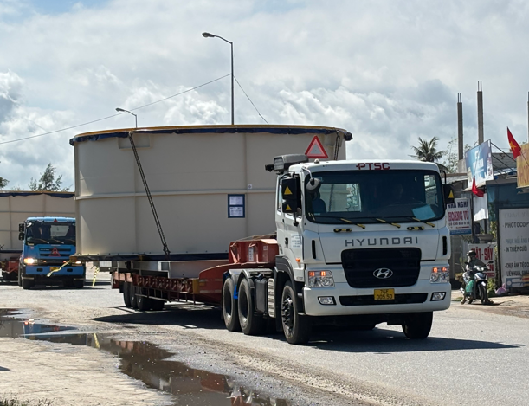
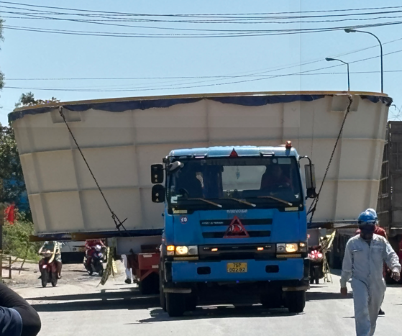
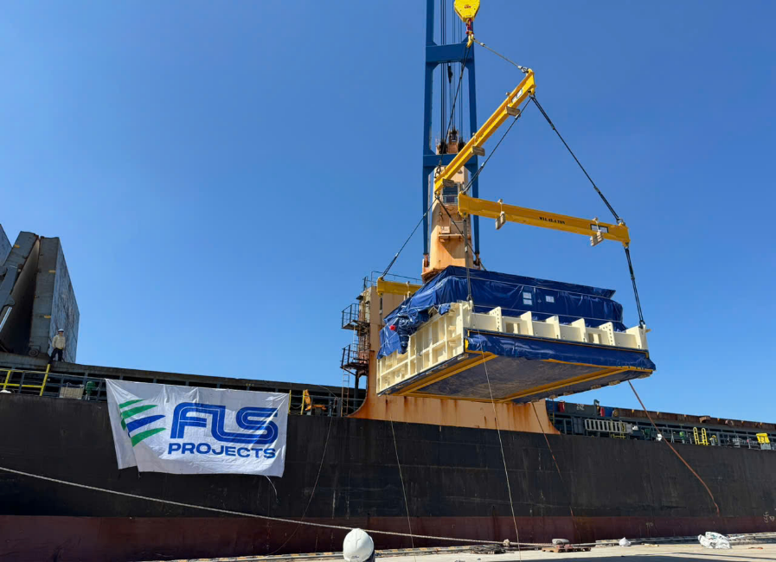
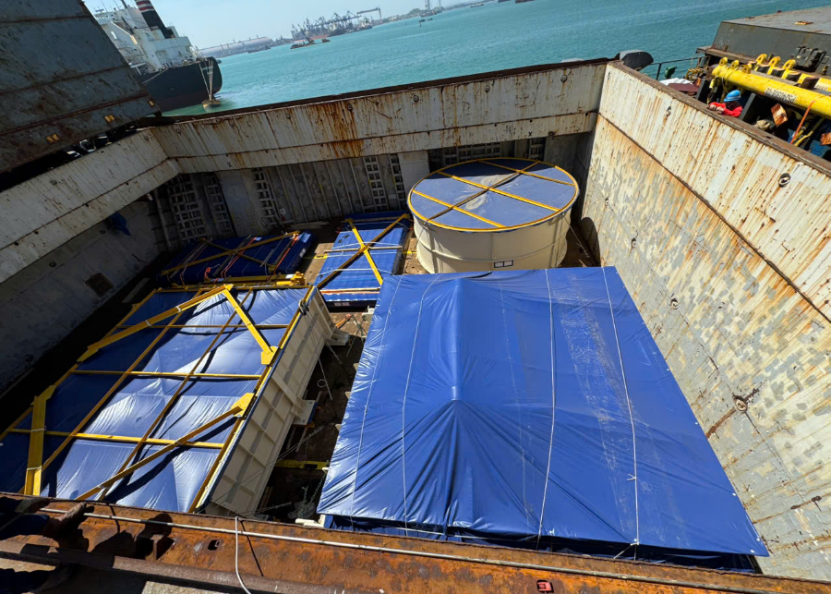
PROJECT REFERENCES
PROJECT REFERENCES
CASE STUDY – PELICAN POINT POWER PLANT PROJECT 1/2
Volume: 28 packages, 3,779 cbm, 341. MT
Origin: Dung Quat, Vietnam
Port of Discharge: Adelaide, Australia
Final Destination: Pelican Point Combined Cycle Power Plant
Apply for a special oversize transportation permit
Transporting cargo from the work-shop to the port of loading
Two specialized electric power teams providing escort services throughout the transportation process to ensure safety and operational efficiency
Third party survey and inspection of the cargo
Coordination and strategic placement of lifting beams to ensure alignment with the appropriate Working Load Limit (WLL) for safe and efficient operations.
Ocean freight from Dung Quat to port of discharge Adelaide
Loading onto vessel incl appropriate cargo stow arrangements. Cargo hold preparation for loading, including layout of dunnage by FLS owned stevedores
Lashing and securing
FLS Port Captains supervised the whole trucking and loading operation
Scope:
1

