Slide 1
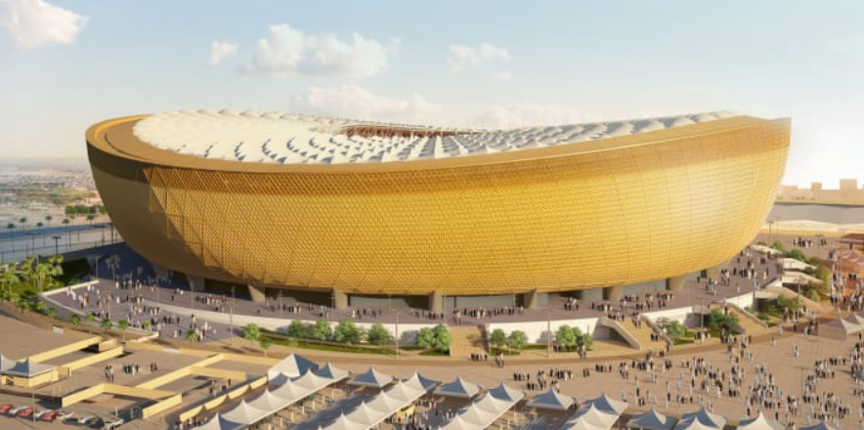
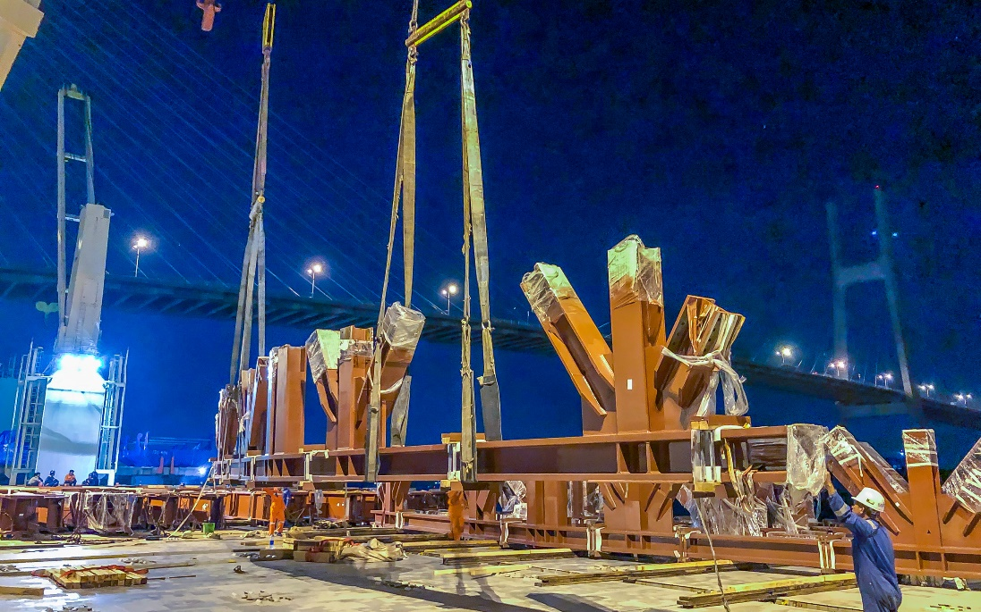
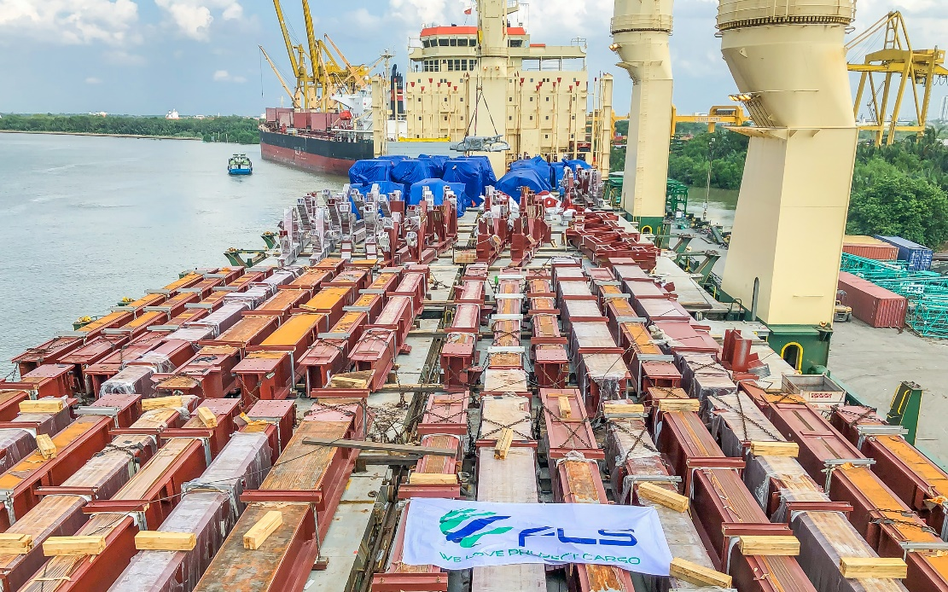
PROJECT REFERENCES
PROJECT REFERENCES
CASE STUDY – LUSAIL WORLD CUP STADIUM
Project Name: Lusail World Cup Stadium
Volume: 6,500 FRT over 4 shipments
Commodity: Structural steel for roof of World Cup 2022 stadium
Origin: Ho Chi Minh City, Vietnam
Destination: Hamad, Qatar
Chartering of suitable vessel + supervising on board
Co-ordination and supervision of the loading operation
Scope:
1

