Slide 1
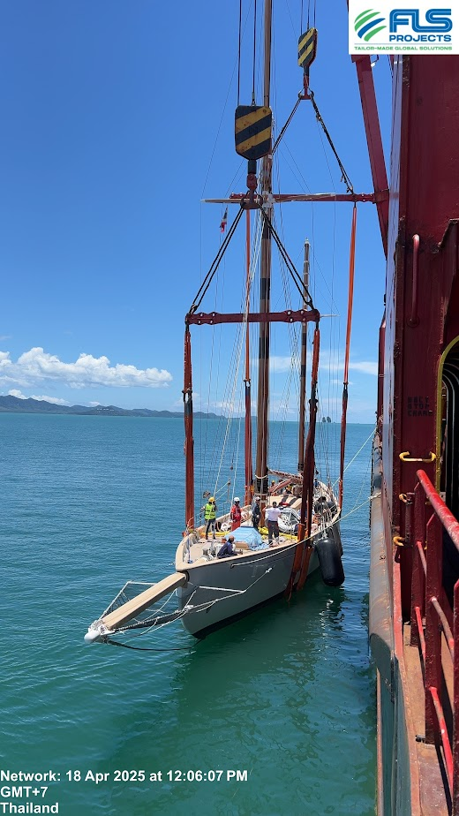
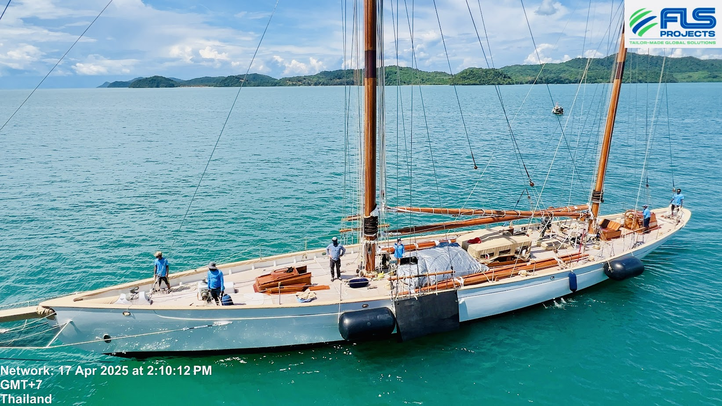
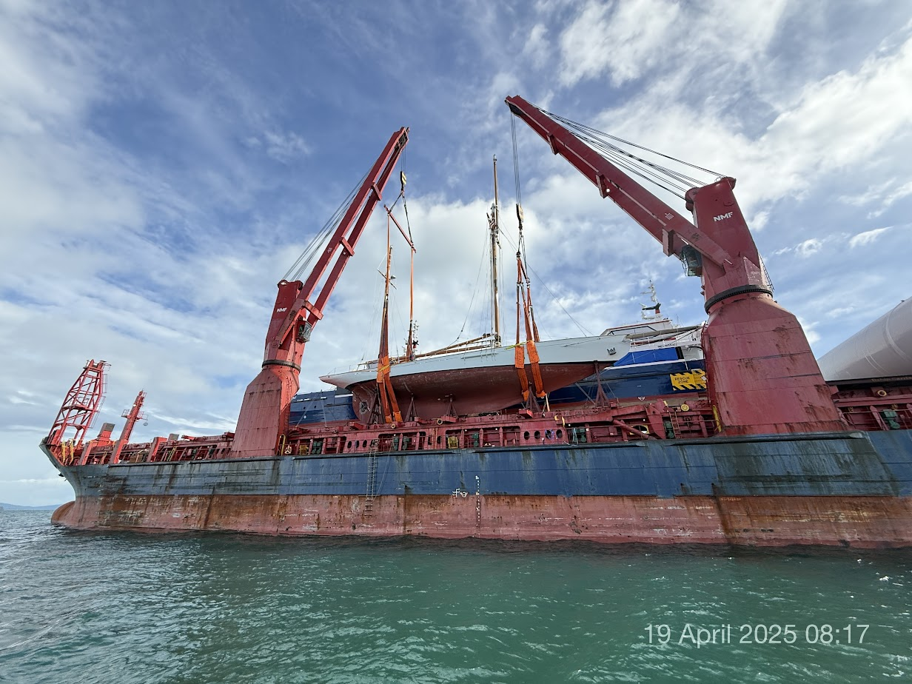
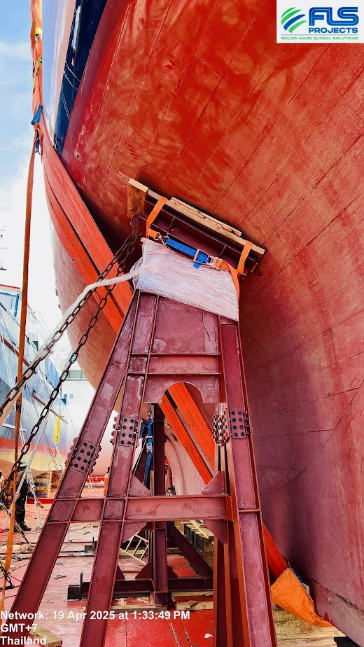
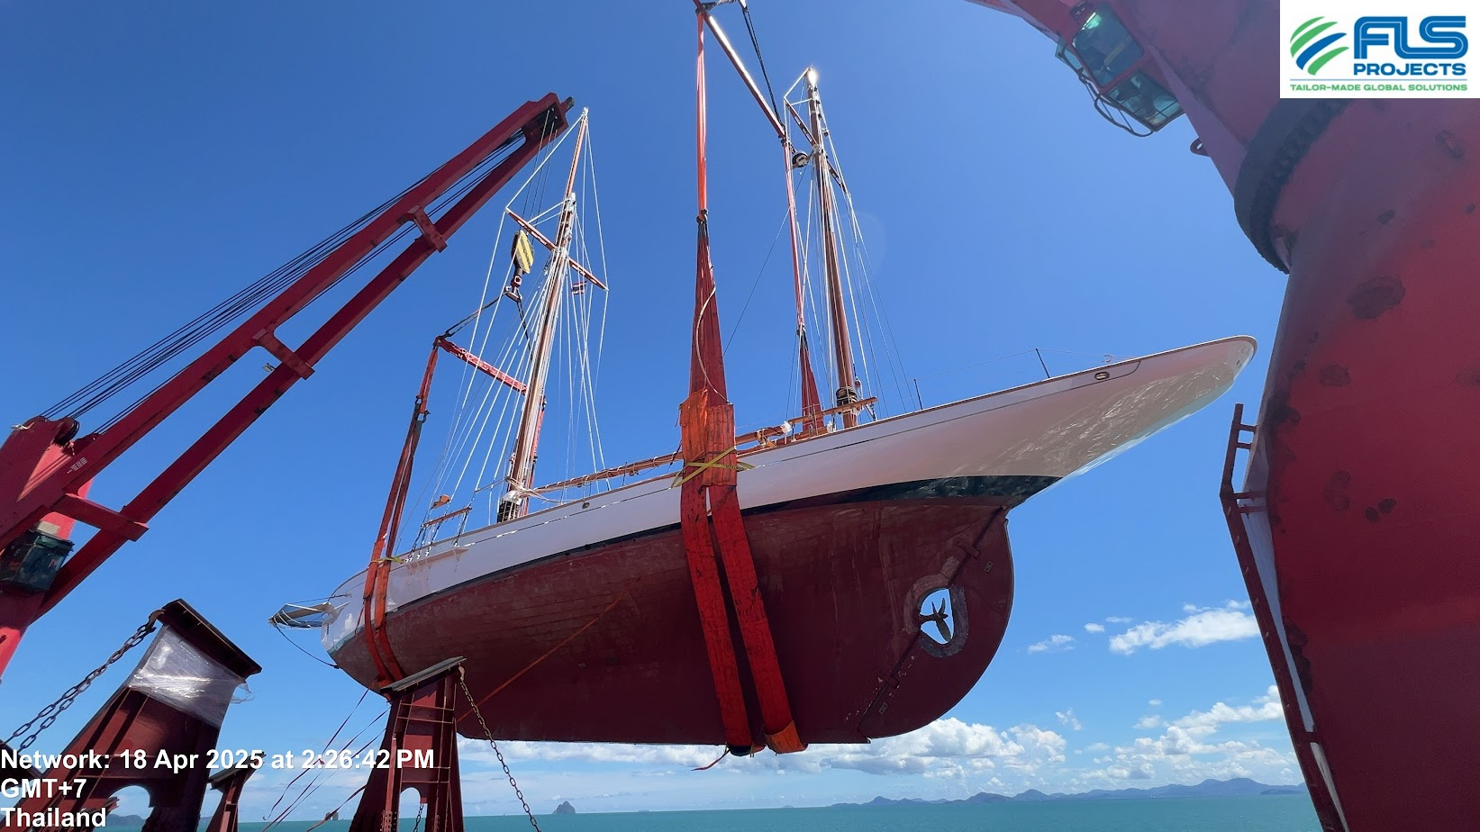
PROJECT REFERENCES
PROJECT REFERENCES
CASE STUDY – CLASSIC YACHT
Commodity: Vintage yacht (built in 1896, est 130yrs old)
Volume: 36.5 x 5.64 x 31 M, 130 MT
Origin: Phuket, Thailand
Destination: Southampton, UK
Challenge:
36m, 130t vintage yacht with fragile structure
Limited structural docs; preservation-first approach require
Custom lift plan with soft slings, dual cranes, bespoke cradle
Synthetic lashings and padded supports to avoid damage during sea transit
Initial wooden choke setup rejected by MWS/client (18/4) due to risk of dislodgement and hull damage
Real-time monitoring and seamless handover ensured preservation
Charter heavy lift vessel with suitable capacity
Deploy divers for sling positioning
In-house stevedores for hooking-on, hooking-off
Protect yacht’s interior and exterior
Supervise loading operations
Conduct lift studies for safe execution
Scope:
1

