Slide 1
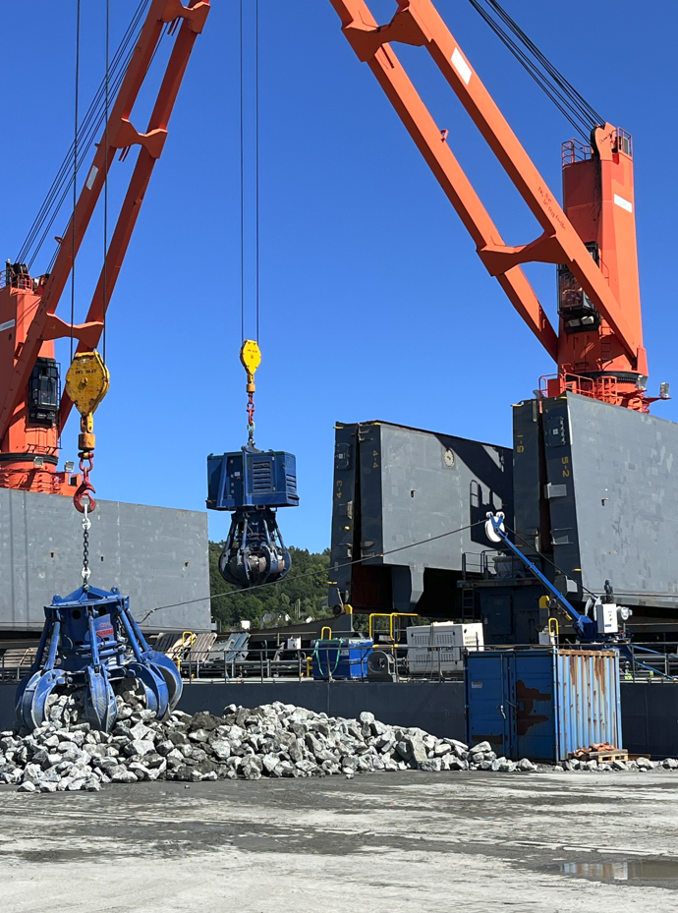
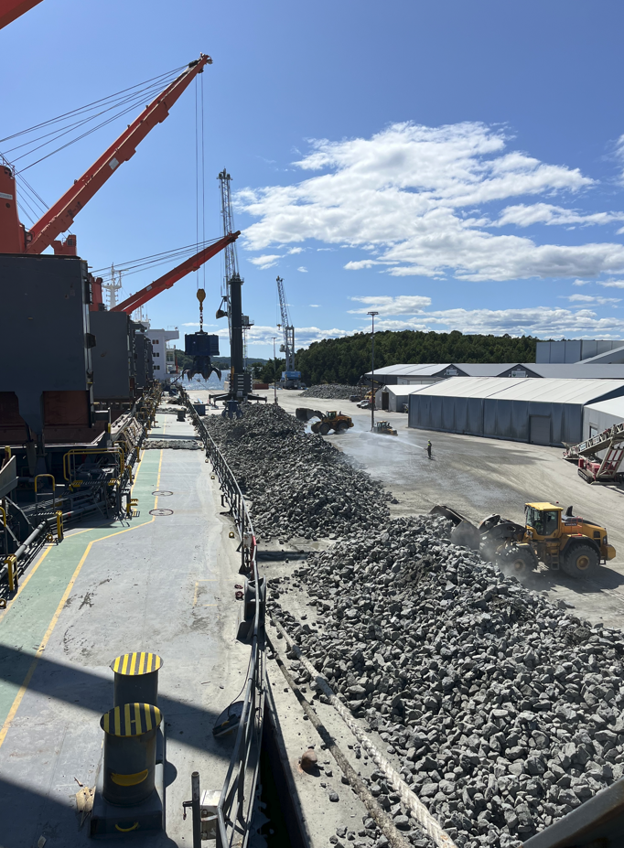
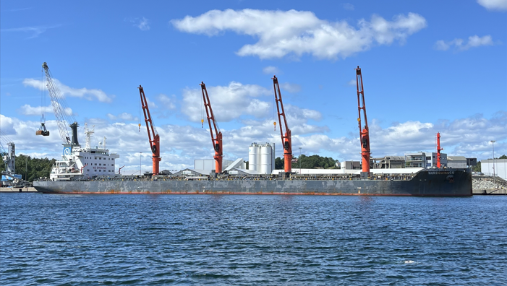

PROJECT REFERENCES
CASE STUDY – LOADING OF HEAVY STONES
Project name:
Commodity: Commodity: Origin: Destination:
Greater Changhua
Heavy stones
Norway
Taiwan
Scope:
Vectura/FLS was contracted to charter a dedicated vessel including the loadout option in Norway.
Due to various restrictions, the loaded was done with heavy duly orange-peel grabs.
Vectura did also the project management including risk assessment.
For internal use only!

