Slide 1
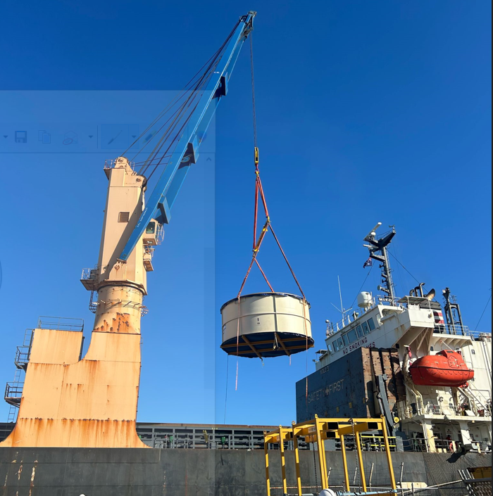
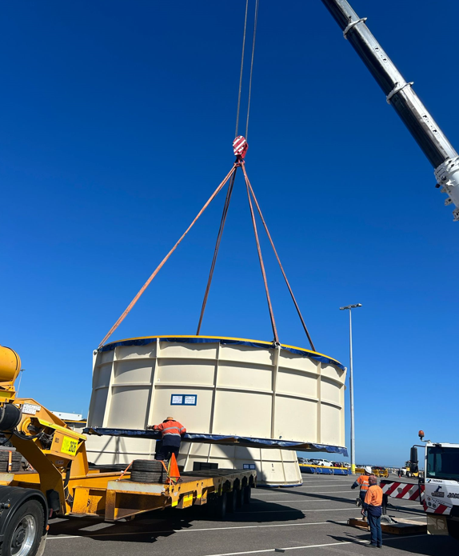
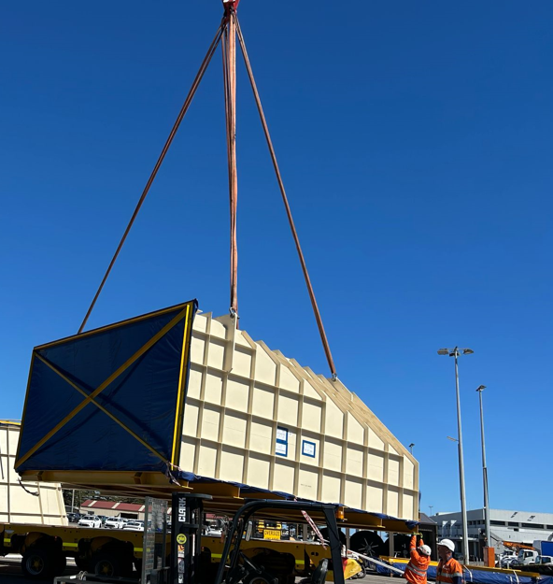
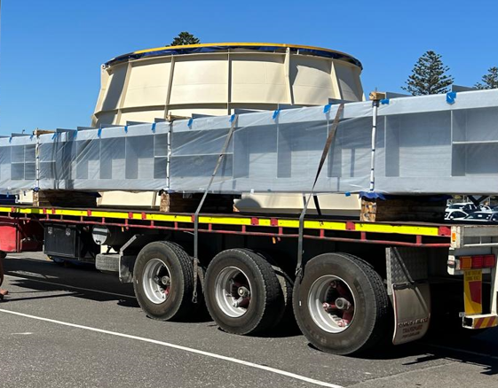
PROJECT REFERENCES
CASE STUDY – PELICAN POINT POWER PLANT PROJECT 2/2
Volume: 28 packages, 3,779 CBM, 341.212 MT
Origin: Dung Quat, Vietnam
Port of Discharge: Adelaide, Australia
Final Destination: Pelican Point Combined Cycle Power Plant
Challenges:
Complexity due to the cargo’s size with max length 15.46M, width 9.55M, height 5.30M
The nearest BBK terminal at the POD to the job site is not workable
Investigate suitable direction to the job site, adjust construction to fit the cargo during transportation
→ We got involved in the discussions at a very early stage, which allowed the client to design and fabricate up to the absolute maximum dimensions.
→ Coordination with carrier for special berthing at RO-RO/ Cruise ship terminal
Scope:
Apply for a special permit in order to berth at the RO-RO/ cruise terminal.
Traffic management survey in Australia
Vessel berthed at a RO-RO/ Cruise ship berth
Cargo unlashing discharge operation, supervision by FLS PM
Due to cargo dimensions, FLS had to remove fencing and widen the gate at the port
Traffic lights, traffic signs had to be removed during the trucking from port to the jobsite
Police escorted our trucks and stopped the traffic when necessary
1

